Slide 1
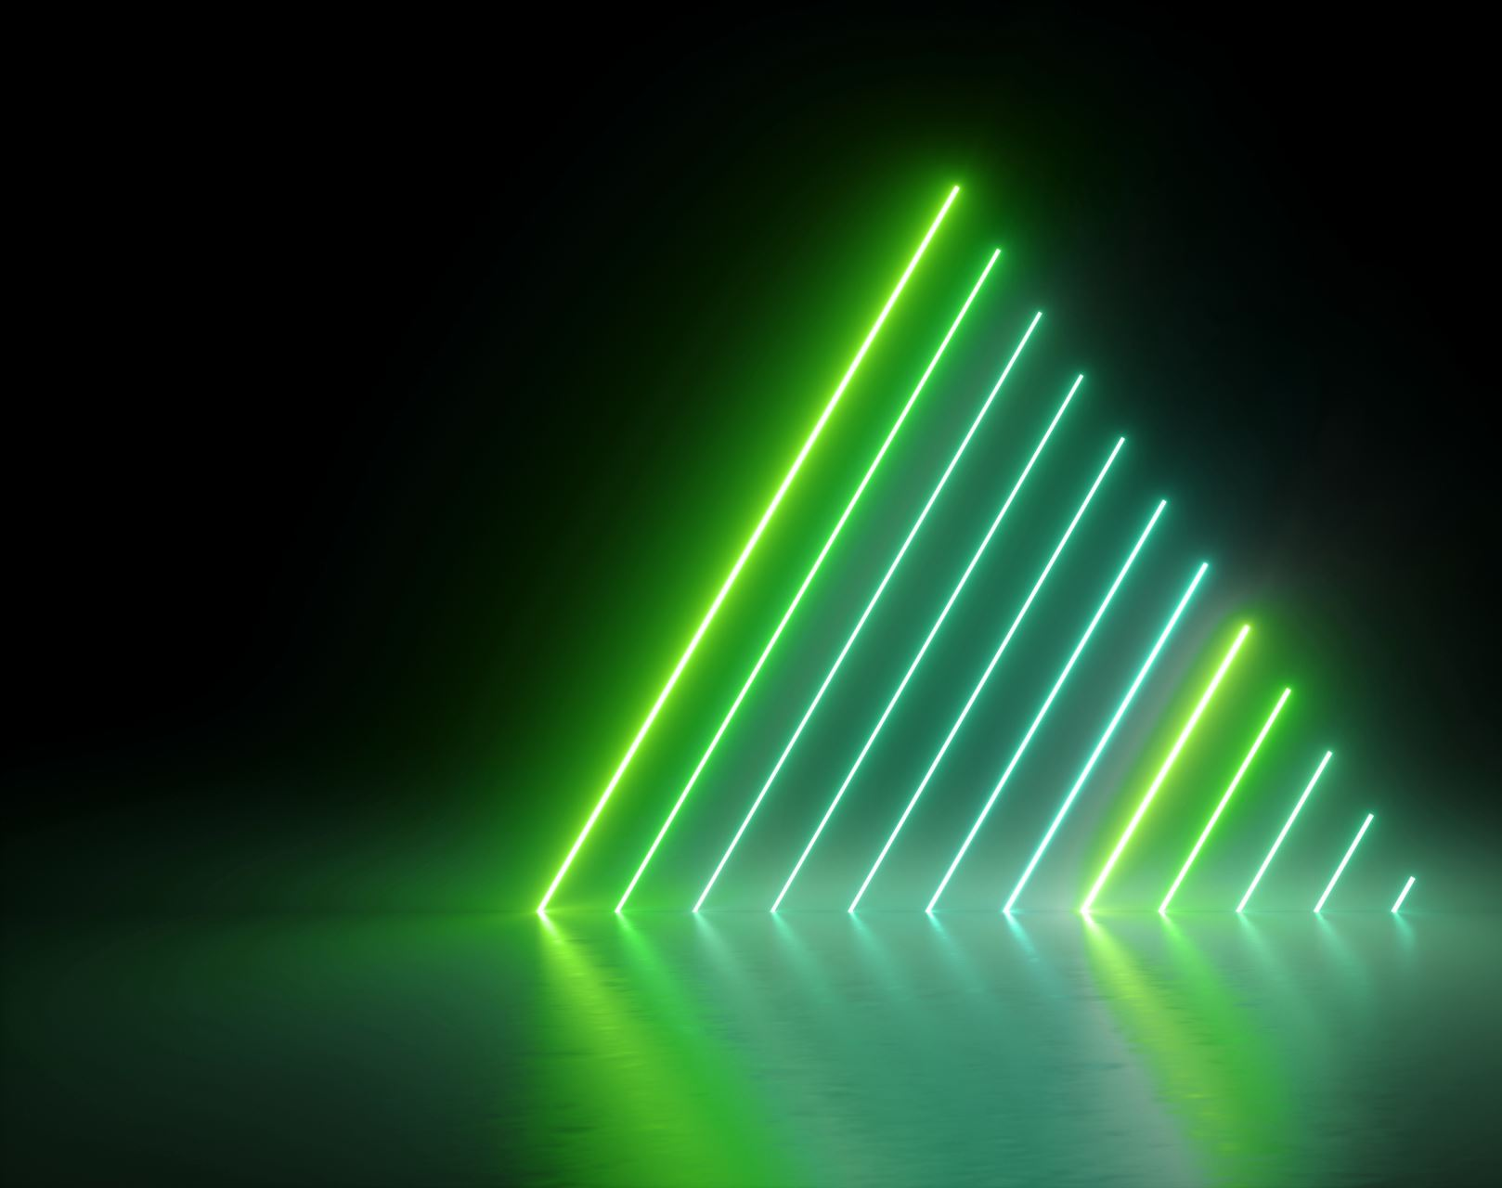
Session 5
Colliders Physics Rigidbody

